Slide 1
Automated Solar Tracking System
19EEE381 – Open Lab Group No. - 06

Slide 2
Team Members:
Krisshanth R – CB.EN.U4ELC22021
Praveenkumar U S - CB.EN.U4ELC22056
Aditya Thannasiappan - CB.EN.U4ELC22061
Pranav Karthikeyan - CB.EN.U4ELC22062

Slide 3
Table of contents
01
02
03
04
05
06
Problem Statement
Objective and Key features
Components List
Budget Estimation
Development Timeline (Week Plan)
Schematic Block Diagram

Slide 4
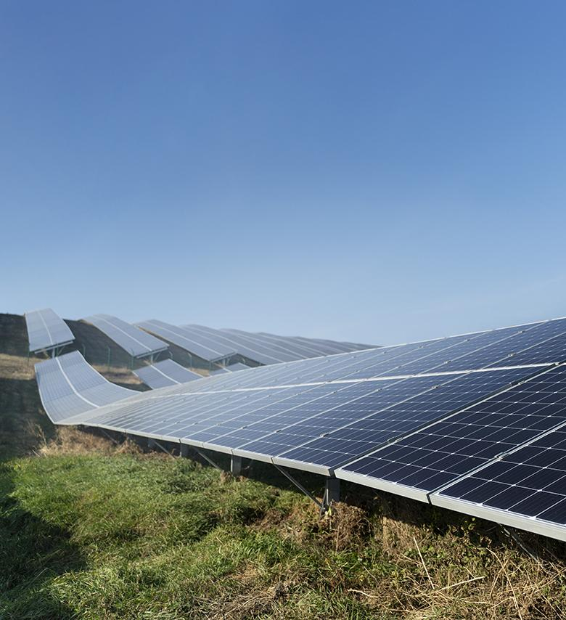
Problem Statement
01
Stationary panels fail to follow the sun's movement
Lack of variable elevation angles affects efficiency
Commercial high-precision trackers are expensive and complex
Objective: Design a cost-effective dual-axis tracking system to improve energy capture

Slide 5
Table of contents
01
02
03
04
05
06
Problem Statement
Objective and Key Features
Components List
Budget Estimation
Development Timeline (Week Plan)
Schematic Block Diagram

Slide 6
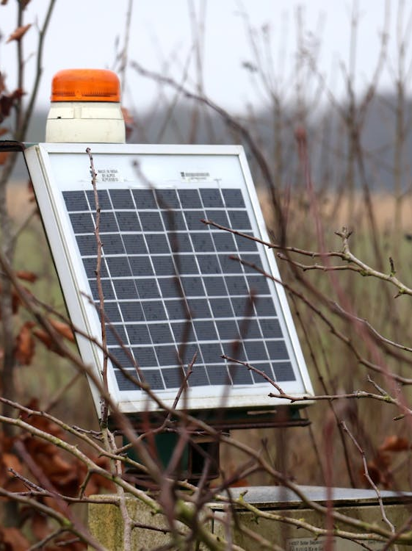
Objective and Key Features
Affordable and efficient dual-axis solar tracking system- Automated sun-tracking mechanism using LDR sensors- Real-time monitoring through OLED display and Blynk app- Utilizes ESP32 for communication and control
02

Slide 7
Table of contents
01
02
03
04
05
06
Problem Statement
Objective and Key Features
Components List
Budget Estimation
Development Timeline (Week Plan)
Schematic Block Diagram

Slide 8
03
Components List
S.No. | Components | Specification
1 | ESP-WROOM-32 | 2.4 GHz, Wi-Fi and Bluetooth, 3.6 V, 80mA
2 | Solar Panel | 6V, 100mAh
3 | LDR (LM393) Sensors | 10k Ohms. 3.3 - 5V
4 | Servo Motors (SG90) | Operating voltage: 3-7.2V
5 | OLED Display | 128x64 resolution, 5V DC
6 | CJMCU-219 INA219 Power Sensor | Voltage: 0-26V Current: 0-3.2A

Slide 9
Table of contents
01
02
03
04
05
06
Problem Statement
Objective and Key Features
Components List
Budget Estimation
Development Timeline (Week Plan)
Schematic Block Diagram

Slide 10
Budget Estimation
04
S.No. | Components | Cost
1 | ESP-WROOM-32 | Rs. 550
2 | Solar Panels (2 units) | Rs. 130
3 | LDR (LM393) Sensors (4 units) | Rs. 260
4 | Servo Motors (SG90) (2 units) | Rs. 400
5 | OLED Display | Rs. 270
6 | CJMCU-219 INA219 Power Sensor | Rs. 100
7 | 3D Model Printing | Rs. 800
Total Cost: |  | Rs. 2803

Slide 11
Table of contents
01
02
03
04
05
06
Problem Statement
Objective and Key Features
Components List
Budget Estimation
Development Timeline (Week Plan)
Schematic Block Diagram

Slide 12
Development Timeline (Week Plan)
05
W1: Topic decision and research discussion
W3: Hardware procurement and assembly
W2: Cost estimation and report creation
W4: Coding – Phase 1 (Wokwi simulation)
W5: Coding – Phase 2 and debugging (Arduino IDE)
W6: Implementation and testing
W7: Code optimization and model tuning

Slide 13
Table of contents
01
02
03
04
05
06
Problem Statement
Objective and Key Features
Components List
Budget Estimation
Development Timeline (Week Plan)
Schematic Block Diagram

Slide 14
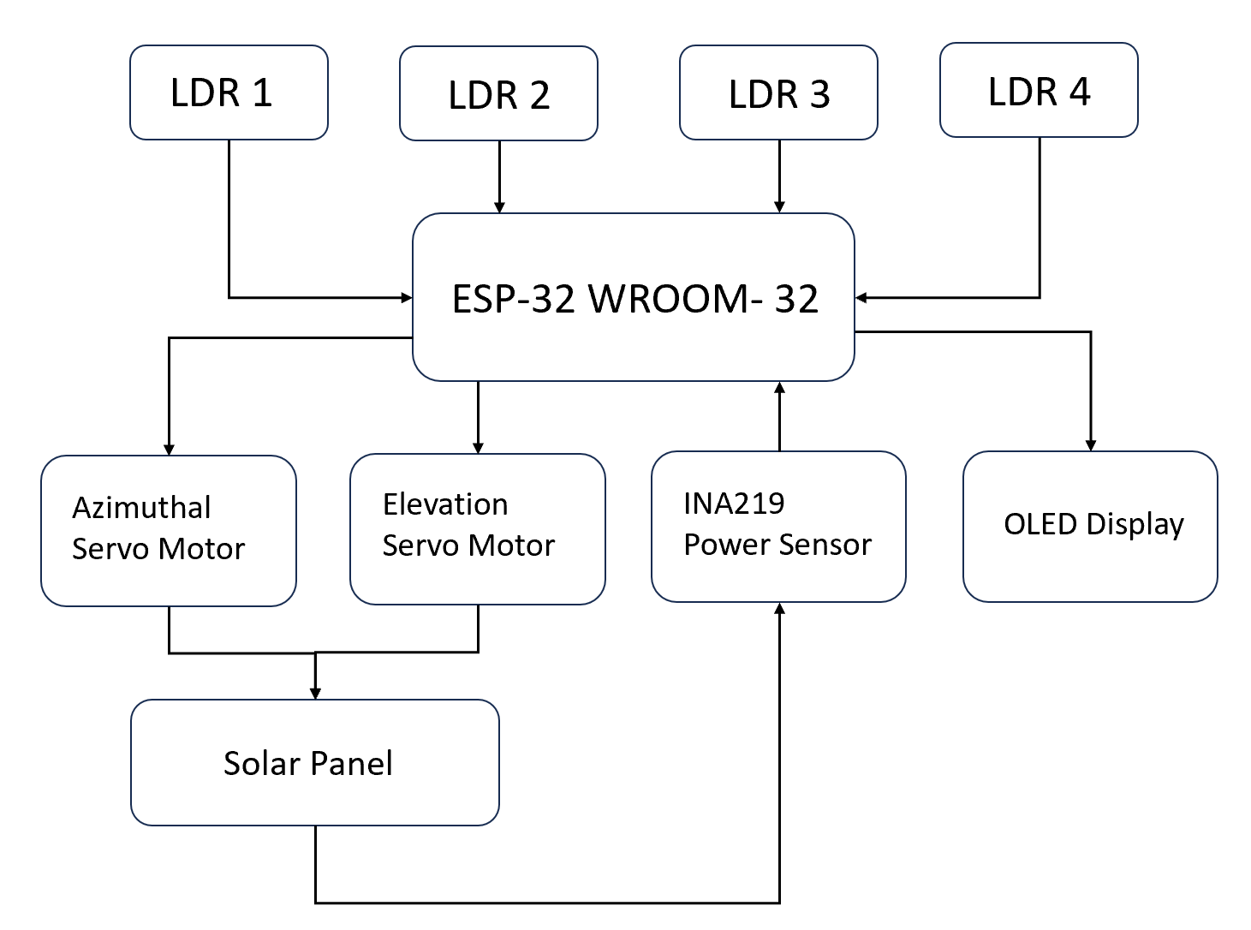
Schematic Block Diagram
06

Slide 15
Table of contents
06
07
08
09
10
Schematic Block Diagram
Testing and Wokwi Simulation
Results
Challenges Faced
Future Scope and Conclusion

Slide 16
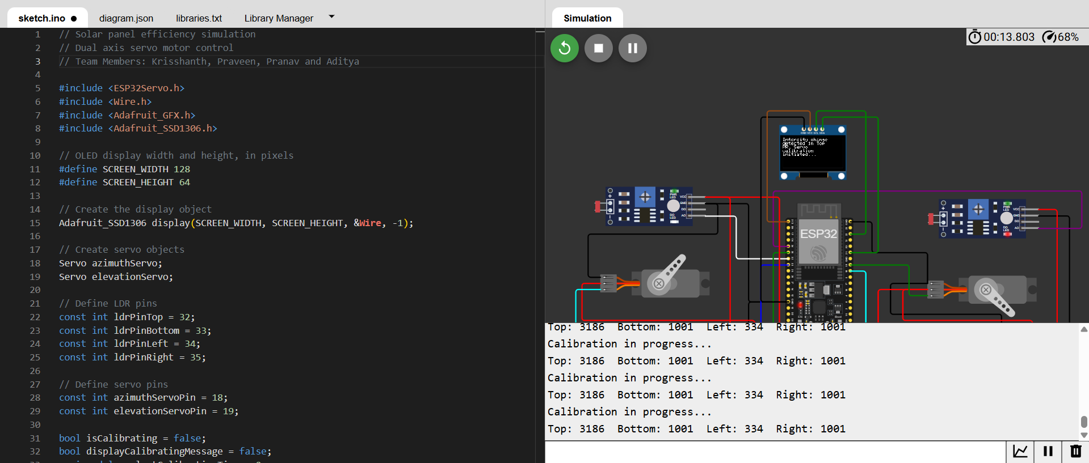
Testing and Wokwi Simulation
07

Slide 17
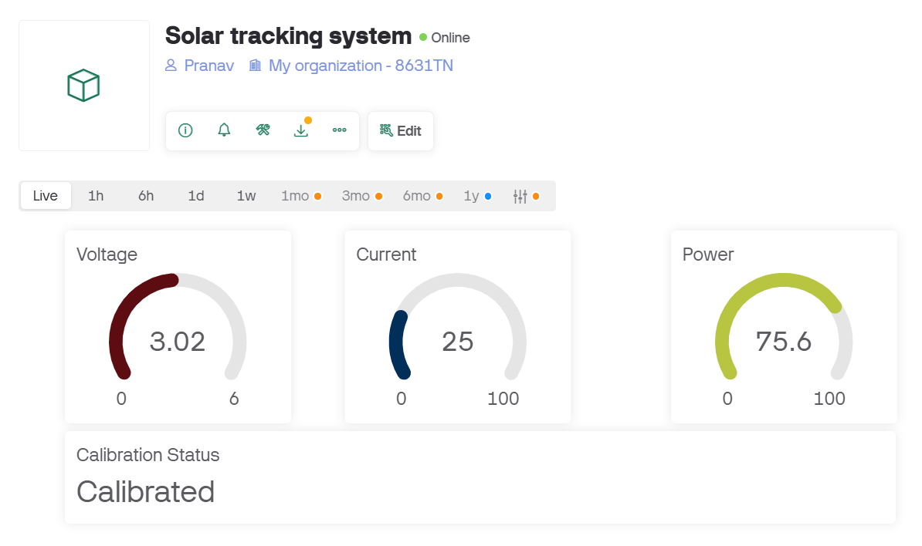
Testing (Blynk web interface)
07

Slide 18
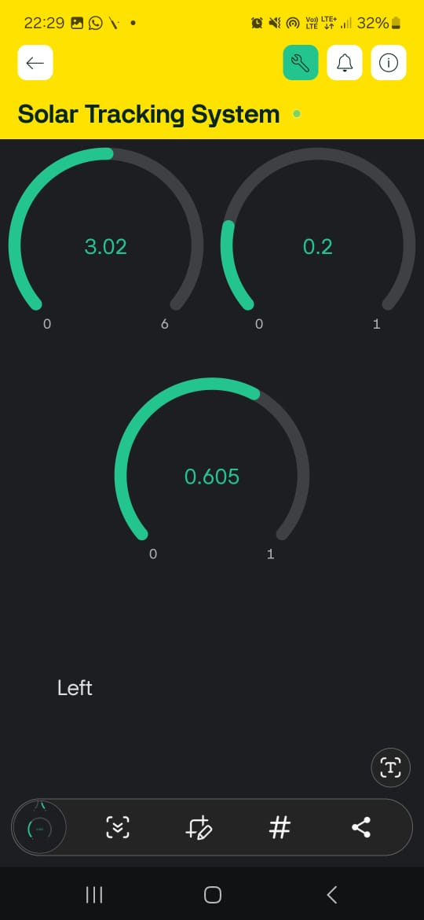
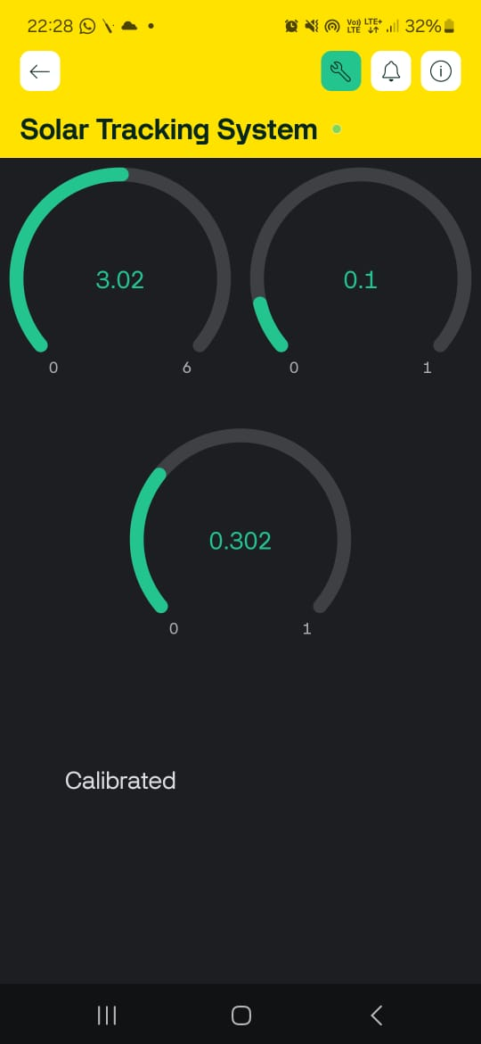
Testing (Blynk App interface)
07

Slide 19
Table of contents
06
07
08
09
10
Schematic Block Diagram
Testing and Wokwi Simulation
Implementation Results
Challenges Faced
Future Scope and Conclusion

Slide 20
Implementation Results
08
Power Output Comparison
Fixed Panel: Less sunlight capture, lower energy
Single-Axis: Moves in one direction, ~30% more energy
Dual-Axis: Follows the sun, ~60% more energy
Data Logging & Analysis
Recorded power at intervals using sensors & IoT (Blynk app).
Compared energy output morning, afternoon, and cloudy days
Energy Gain Trends
Dual-axis gave the highest output.
Single-axis performed better than fixed panels.
Tracking helped even on cloudy days.

Slide 21
Table of contents
06
07
08
09
10
Schematic Block Diagram
Testing and Wokwi Simulation
Implementation Results
Challenges Faced
Future Scope and Conclusion

Slide 22
Challenges Faced
09
Sensor calibration issues
Debugging connectivity errors with ESP32
Stability concerns of procured 3D Model during swivel greater than 30°.
Stability issues faced when tested in extreme weather conditions.

Slide 23
Table of contents
06
07
08
09
10
Schematic Block Diagram
Testing and Wokwi Simulation
Implementation Results
Challenges Faced
Future Scope and Conclusion

Slide 24
Future Scope and Conclusion
10
Integration of AI for improved tracking precision.
Cloud-based data storage for advanced monitoring and analytics.
Expansion to larger solar arrays for industrial applications.
Conclusion:
Our system successfully enhances solar energy efficiency through a cost-effective dual-axis tracking mechanism.

Slide 25
THANK YOU!

